Slide 1
AdaNet for Concrete Strength prediction

Slide 2
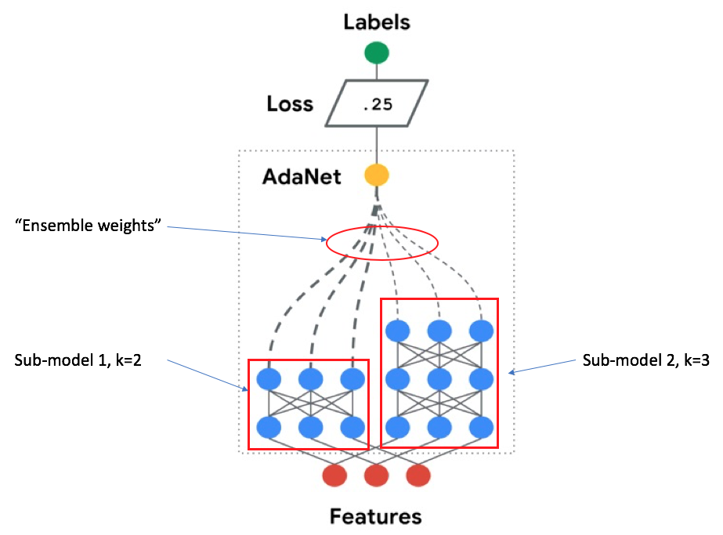
Adaptive Structural Learning (AdaNet)
Ensemble of several subnetworks
Include a candidate subnetwork only when it improves the ensemble’s training loss
https://ai.googleblog.com/2018/10/introducing-adanet-fast-and-flexible.html

Slide 3
AdaNet
Generating subnetworks
Grouping strategy
Combining each group of subnetworks (ensembles)
The best ensemble moves onto the next iteration
Evaluating loss of ensembles

Slide 4
AdaNet
Current Model:
Comparing two subnetworks at each iteration
One of the subnetworks has one additional hidden layer
The number of hidden layer starts from zero

Slide 5
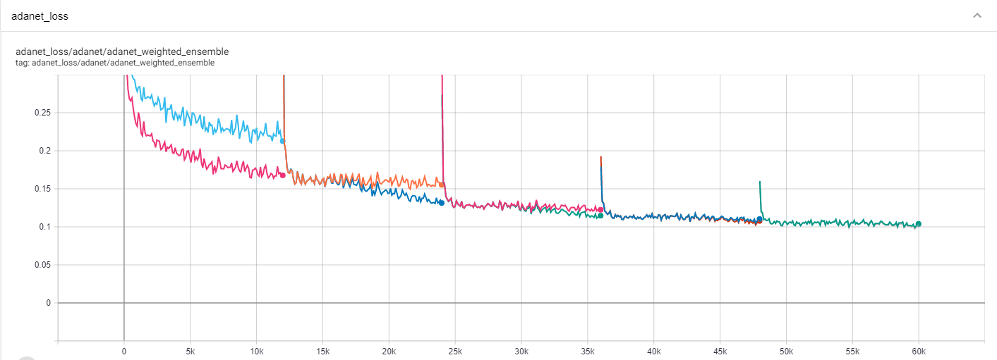
AdaNet
iterations | validation R2 | training R2 | Picked model
1 | 0.7649 | 0.8926 | 2 layers DNN
2 | 0.7762 | 0.9263 | 3 layers DNN
3 | 0.7797 | 0.9422 | 4 layers DNN
4 | 0.7824 | 0.9522 | 5 layers DNN
5 | 0.7822 | 0.9557 | 5 layers DNN
Batch size: 128
# of neurons: 64
Lambda: 0.005
Beta: 0.05
Steps: 12000

Slide 6
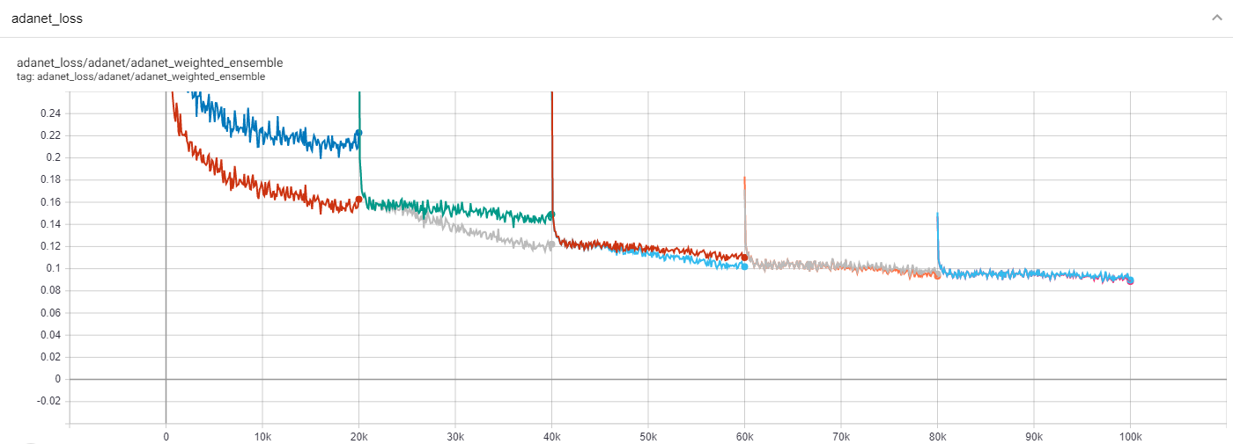
AdaNet
iterations | validation R2 | training R2 | Picked model
1 | 0.7474 | 0.8933 | 2 layers DNN
2 | 0.749 | 0.9341 | 3 layers DNN
3 | 0.7543 | 0.9527 | 4 layers DNN
4 | 0.7652 | 0.9623 | 5 layers DNN
5 | 0.7709 | 0.9681 | 6 layers DNN
Batch size: 128
# of neurons: 64
Lambda: 0.005
Beta: 0.05
Steps: 20000

Slide 7
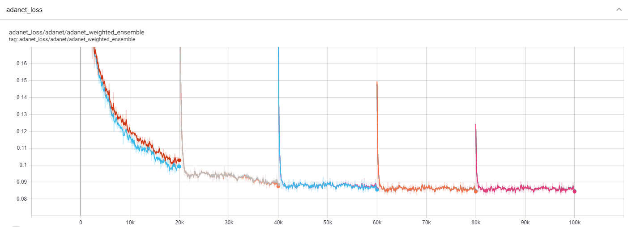
AdaNet
iterations | validation R2 | training R2 | Picked model
1 | 0.7458 | 0.9644 | 6 layers DNN
2 | 0.7702 | 0.9704 | 7 layers DNN
3 | 0.7783 | 0.9731 | 7 layers DNN
4 | 0.7831 | 0.9734 | 8 layers DNN
5 | 0.7835 | 0.9739 | 8 layers DNN
Batch size: 128
# of neurons: 64
Lambda: 0.005
Beta: 0.05
Steps: 20000

Slide 8
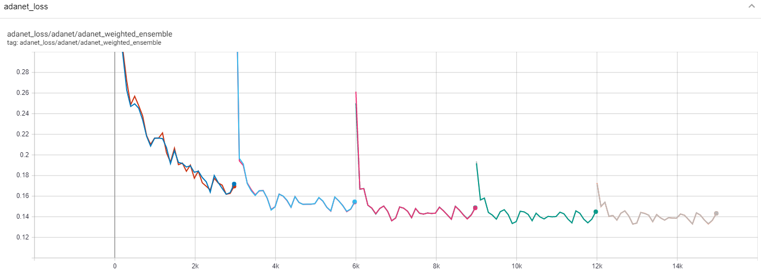
AdaNet
iterations | validation R2 | training R2 | Picked model
1 | 0.7815 | 0.9045 | 6 layers DNN
2 | 0.7885 | 0.9075 | 6 layers DNN
3 | 0.7964 | 0.9128 | 6 layers DNN
4 | 0.7989 | 0.9164 | 6 layers DNN
5 | 0.8021 | 0.918 | 6 layers DNN
Batch size: 128
# of neurons: 64
Lambda: 0.005
Beta: 0.05
Steps: 3000

Slide 9
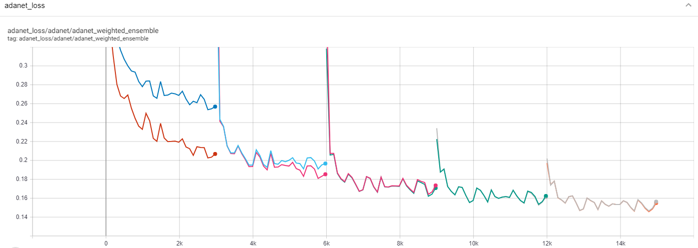
AdaNet
iterations | validation R2 | training R2 | Picked model
1 | 0.7764 | 0.8552 | 2 layers DNN
2 | 0.7854 | 0.8719 | 3 layers DNN
3 | 0.7863 | 0.8877 | 4 layers DNN
4 | 0.7946 | 0.8973 | 5 layers DNN
5 | 0.7999 | 0.9065 | 6 layers DNN
Batch size: 128
# of neurons: 64
Lambda: 0.005
Beta: 0.05
Steps: 3000

Slide 10

JAX
JAX is Autograd and XLA, brought together for high-performance machine learning research
Automatically differentiate native Python and Numpy code
Run NumPy programs on GPUs and TPUs
Build custom optimizers, evaluators, training models on NumPy with GPUs and TPUs support
Machine Learning libraries are in the early stage. (less than six months)
Haiku
Flax
https://github.com/google/jax

Slide 11
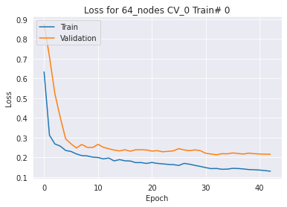
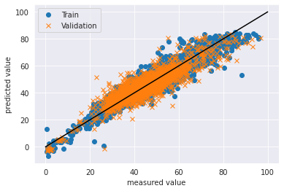
DNN
6L DNN | validation R2 | training R2
 | 0.7934 | 0.8863

